Slide 1
Chemical Pathology
DR. P. THAMAINI

Slide 2
Objectives
Define clinical chemistry.
Describe the role of clinical chemistry in medicine practice.
Principles of requesting tests
Interpretation of laboratory results
Effects of analytical errors and physiological factors and disease on results
Role of biochemistry in screening and differential diagnosis

Slide 3
Definitions
Clinical Biochemistry, Clinical Chemistry and chemical pathology are all terms which refer to the branch of laboratory medicine in which chemical and biochemical methods are applied to the study of disease.
This includes all non morphological pathology tests.
These tests are usually carried out on blood and urine but may also be applied to other body fluids such as gastric aspirates and cerebrospinal fluids.
In most laboratories these tests comprise one third to half the total volume of tests performed.

Slide 4
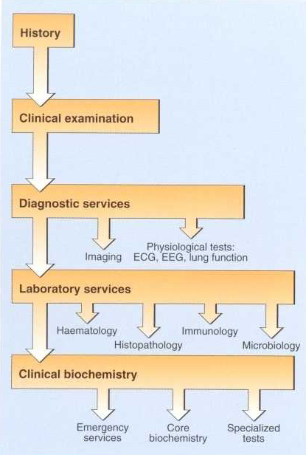
The place of clinical biochemistry in medicine

Slide 5
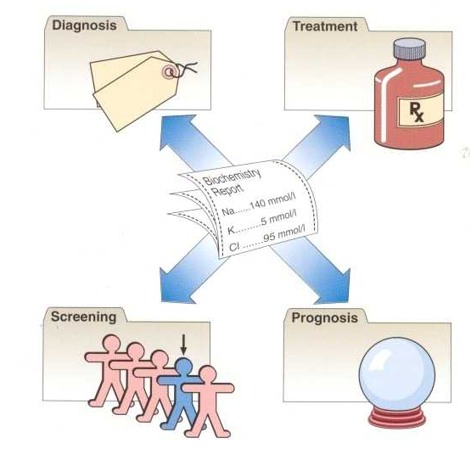
How biochemistry tests are used

Slide 6
Testing may this be done to :
Confirm diagnosis.
Aid in differential diagnosis.
Refine a diagnosis.
Assess severity of disease.
Monitor progress.
Detect complications or side effects.
Monitor therapy.

Slide 7
Requests
Should have
Patient name and identification
Age
Sex
Clinical information PERTINENT TO THE TEST!
Type of specimen collected

Slide 8
Specimen collection
Types of specimens
Blood – venous, capillary and arterial
Urine
CSF
Other body fluids
Cells and tissues
Saliva
Pus
It is very important that the correct specimen at the correct time in the correct container is collected

Slide 9
Precautions
During collection ensure personal safety with gloves and other protective equipment used
Ensure proper collection container and technique as well as proper specimen is collected for example arterial blood is needed for blood gas analysis and you must submit blood for sugar analysis in a fluoride tube.
During transport always follow instructions. For example some specimens require storage on ice or immediate analysis.
Safety during transport.

Slide 10
Patient Preparation
Some tests require prior preparation before sampling e.g. fasting, positioning, relaxing
Time of day

Slide 11
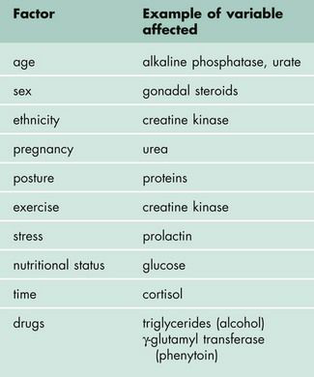

Slide 12
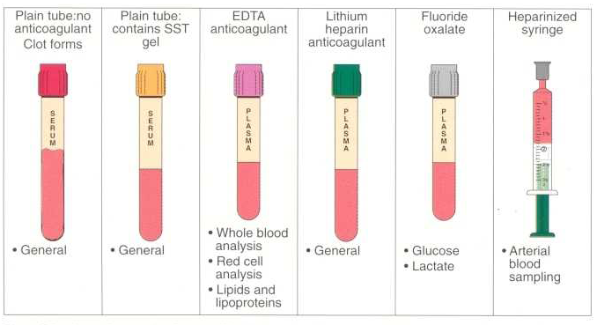
Blood specimens

Slide 13
Analysis of samples
The ideal analytical method is
Accurate: It gives a correct result
Precise - that is the same if repeated
Sensitive - measures low concentrations of the analyte
Specific - not subject to interference by other substances
Other ideals:
cheap, simple and quick to perform
Most analytical methods today are subject to rigorous quality control and quality assurance procedures.
Nevertheless a degree of imprecision or analytical variation in a result.

Slide 14
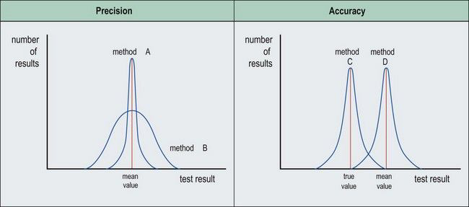

Slide 15
Sources of error
Errors can occur at various stages in the process:
Pre-analytical
Analytical
Post-analytical
Analytical errors can be systematic (also known as bias) or random.
Many of the few errors that do occur even in good laboratories are detected by quality control procedures,
The risk of errors occurring can never be entirely eliminated.

Slide 16
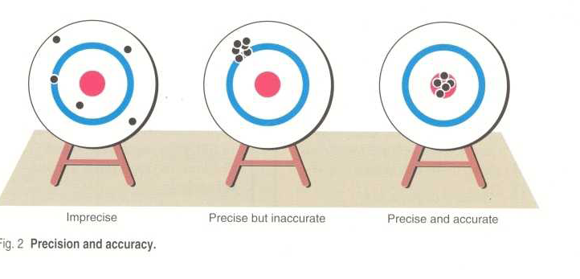
Accuracy and precision
Precision is reproducibility of an analytical method
Accuracy refers to how close to the measured value is to the actual value.

Slide 17
Interpretation of results
Is it normal?
Is it significantly different from any previous results?
Is it consistent with the clinical findings?

Slide 18
What is normal?
Biochemical results are usually compared to a set of values considered to represent he values in a healthy population.
Most of these values are chosen arbitrarily to include 95% of the population so by definition 5% of normal healthy population will fall outside the reference range.
An abnormal result does not always indicate the presence of a pathological process, nor a normal result its absence.

Slide 19
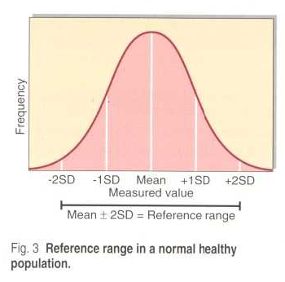
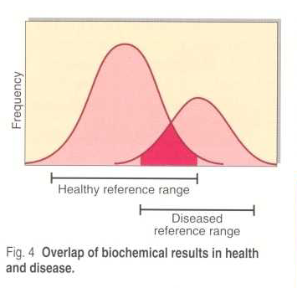

Slide 20
Is it different?
If the result of a previous test is available, the clinician will be able to compare the results and decide whether any difference between them is significant.
This will depend on the analytical precision of the assay and the biological variation
Biological variation: deviations for repeated measurements made in a group of healthy subjects over a period.

Slide 21
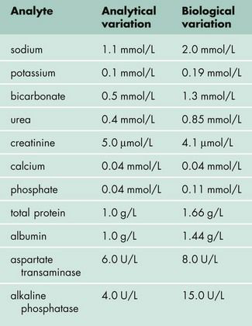

Slide 22
Biological sources of variation
Within individual variation
Diet
Exercise
Posture
Drugs
Previous medical history
Time of day
Stress/ anxiety
Menstrual cycle

Slide 23
Biological sources of variation
Between individual variation
Sex
Age
Race

Slide 24
Is it consistent with clinical findings?
If the result is consistent with clinical findings, it is evidence in favour of the clinical diagnosis.
If it is not consistent, the explanation must be sought – see mistakes
If the result is confirmed on repeat testing, the utility of the test in the clinical context should be considered and the clinical diagnosis itself may have to be reviewed. (D-dimer)

Slide 25
The clinical utility of laboratory investigations
In using the result of a test, it is important to know how reliable the test is and how suitable it is for its intended purpose.
Various properties of a test can be calculated to provide this information.

Slide 26


The clinical utility of laboratory investigations
Sensitivity refers to percentage of positive results in patients with a particular disease. (true positive value)
Specificity refers to the percentage of negative results of a test in people without the disease. (True Negative Value)

Slide 27
The clinical utility of laboratory investigations
Because the ranges of values for a test result in health and disease overlap, some patients with disease will have results within the reference range (false negatives), while some individuals free of disease will have results outside this range (false positives).
If the diagnostic cut-off value for a test is set too high, there will be no false positives, but many false negatives; specificity is increased but sensitivity decreases.
If the diagnostic cut-off value is set too low, the number of false positives, and sensitivity, increases, at the expense of a decrease in specificity.

Slide 28
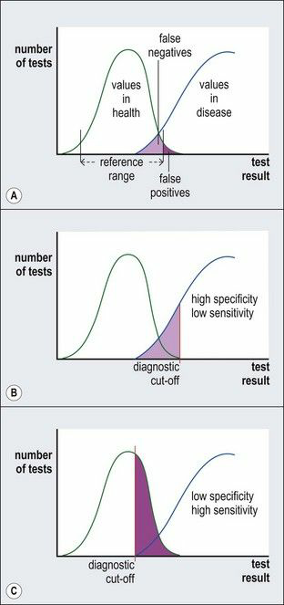

Slide 29
The clinical utility of laboratory investigations
Whether it is desirable to maximize specificity or sensitivity depends on the nature of the condition that the test is used to diagnose and the consequences of making an incorrect diagnosis.
Sensitivity is paramount in a screening test for a harmful condition, but the inevitable false positive results mean that all positive results will have to be investigated further.
However, in selecting patients for a trial of a new treatment, a highly specific test is more appropriate to ensure that the treatment is being given only to patients who have a particular condition.

Slide 30

The clinical utility of laboratory investigations
Efficiency - the number of correct results divided by the total number of tests.
When sensitivity and specificity are equally important, the test with the greatest efficiency should be used.

Slide 31
The clinical utility of laboratory investigations
The ability of a test to diagnose disease depends on the prevalence of the condition in the population being studied (prevalence is the number of people with the condition in relation to the population).
This ability is given by the ‘predictive value’.

Slide 32

The clinical utility of laboratory investigations
A high predictive value for a positive test is important if the management of a patient with a true positive result would be dangerous if applied to someone with a false positive result.

Slide 33

The clinical utility of laboratory investigations
However, when a test is used for screening the appropriate management is to perform further tests.
In order not to miss cases, a screening test should have a very high negative predictive value

Slide 34
Evidence-based clinical biochemistry
Most clinicians use laboratory tests primarily on the basis of their own clinical expertise
Ideally, tests should be chosen on the basis of evidence of their utility, and their results used on the basis of outcome measures. Such an approach is advocated as part of the practice of evidence-based medicine, and could be facilitated by the use of test characteristics such as have been discussed above.

Slide 35
Screening
Tests are carried out on a healthy population to try and detect presymptomatic or early disease.
Done when:
Disease is common or life threatening.
Test used is sensitive and specific and acceptable to the population being screened.
Facilities for follow-up and treatment are available if disease diagnosed.
Effective treatment available.
Financial viability is assured.

Slide 36
Point of care testing
Why?
Convenience
Rapidity of result
Commercial profit

Slide 37
Testing outside the laboratory
Examples
Home glucose monitoring
Home pregnancy kits
Alcohol testing by police
Urinalysis in doctor’s office
Blood gases in ICU and emergency room setting
Bilirubin sticks in neonatal units

Slide 38
Testing outside the laboratory
Problems in outside laboratory testing
Costs are higher
Responsibility for testing falls on untrained person
Analytical problems due usually to operator error e.g. not calibrating the machine for testing
Interpretation problems for example if performed on wrong sample or wrong patient.

Slide 39
Summary
What you should know by now:
What is clinical biochemistry, what does the chemical laboratory do for you?
How to use the chemical pathology laboratory i.e. what test to do and how to do collect the necessary specimen.
Interpreting a chemical pathology laboratory result- what is normal, what is abnormal, what to do with the abnormal

Slide 40
References
Clinical Biochemistry: An Illustrated Color Text
Clinical Chemistry, Seventh Edition.

